Slide 1
MPI Introduction
Or How to Avoid My Nightmare

Slide 2
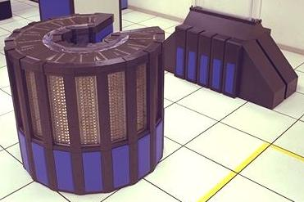
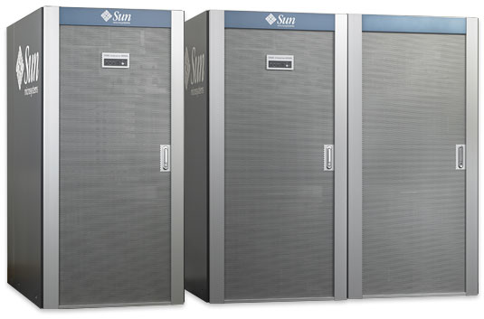
Big Systems
Cray 2 Sun M9000
Large # of processors w/ large local memory
Easy to program
pthread_create(), tuned libraries that automatically get you performance
Don't cluster well, usually needs special knowledge to manage them
Not geared towards modern paradigms like N-parallelizable problems(GPU, large clusters)

Slide 3
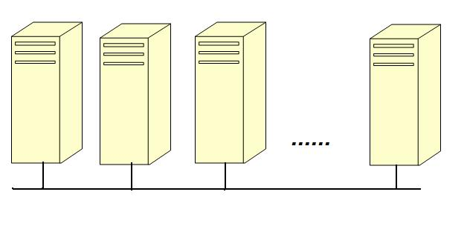
MPI
MPI is a language-independent communications protocol used to program parallel computers.
The app is started on each "node“, then uses the MPI library to co-ordinate communication.

Slide 4
Torque/Maui
Torque is a batch scheduling system that is a derivative to the Portable Batch System (PBS) from NASA.
Maui is an external scheduler for the PBS resource management system. In this configuration, PBS manages the job queue and the compute resources while Maui queries the PBS Server and the PBS MOM's to obtain up to date job and node information.

Slide 5
Torque/Maui commands
freenodes – displays a list of available nodes
Node21
state = free
np = 8
properties = AMD,opteron,OS2352,cuda,2.10
qstat - show status of pbs batch jobs
Job id Name User Time Use S Queue
------------------------- ---------------- --------------- -------- - -----
964.darkcity ..._node12_trash aspensys 630:41:5 R batch
989.darkcity ...renb120n42000 jdsmith 810:32:1 R batch
1020.darkcity Disk-testing joed 00:00:00 R batch
1027.darkcity pi3p-test-brad bwalker 0 R batch

Slide 6
Torque/Maui commands – cont.
qsub - submit pbs job
- usually need a script file
#! /bin/csh
#PBS -N pi3p-test-brad
#PBS -l nodes=2:ppn=8
cd /home/bwalker/tmp/MPI_examples
mpiexec hello_world
qsub qsub-test
qdel - delete pbs batch job
bwalker@darkcity:~/tmp/MPI_examples[1023]>qsub qsub-test
1029.darkcity
bwalker@darkcity:~/tmp/MPI_examples[1024]>qstat
Job id Name User Time Use S Queue
------------------------- ---------------- --------------- -------- - -----
989.darkcity ...renb120n42000 jdsmith 810:41:0 R batch
1029.darkcity pi3p-test-brad bwalker 0 R batch
bwalker@darkcity:~/tmp/MPI_examples[1025]>qdel 1029.darkcity
qdel: Request invalid for state of job MSG=invalid state for job – COMPLETE 1029.darkcity

Slide 7
Steps for Debugging
Make sure that MPI_hello_world works!
Make sure you can ssh into each machine that will potentially run your job and you have the correct environment set up
Make sure you have the job submission script correct
Make sure your app builds/executes correctly without MPI
Build/Test your app with MPI

Slide 8
hello_world.c
/*
"Hello World" Type MPI Test Program
mpicc -o hello_world hello_world.c
*/
#include <string.h>
#include <unistd.h>
#include <stdio.h>
#include "mpi.h"
#define BUFSIZE 256
#define TAG 0
int main(int argc, char *argv[])
{
char idstr[256];
char buff[BUFSIZE];
char hostname[BUFSIZE];
int numprocs;
int myid;
int i;
MPI_Status stat;
MPI_Init(&argc,&argv); /* all MPI programs start with MPI_Init; all 'N' processes exist thereafter */
MPI_Comm_size(MPI_COMM_WORLD,&numprocs); /* find out how big the SPMD world is */
MPI_Comm_rank(MPI_COMM_WORLD,&myid); /* and this processes' rank is */

Slide 9
hello_world.c – cont.
/* At this point, all the programs are running equivalently, the rank is used to
distinguish the roles of the programs in the SPMD model, with rank 0 often used
specially... */
if(myid == 0) {
printf("%d: We have %d processors\n", myid, numprocs);
for(i=1;i<numprocs;i++) {
sprintf(buff, "Hello %d! ", i);
MPI_Send(buff, BUFSIZE, MPI_CHAR, i, TAG, MPI_COMM_WORLD);
}
for(i=1;i<numprocs;i++) {
MPI_Recv(buff, BUFSIZE, MPI_CHAR, i, TAG, MPI_COMM_WORLD, &stat);
printf("%d: %s\n", myid, buff);
}
} else {
/* receive from rank 0: */
MPI_Recv(buff, BUFSIZE, MPI_CHAR, 0, TAG, MPI_COMM_WORLD, &stat);
sprintf(idstr, "Processor %d ", myid);
strcat(buff, idstr);

Slide 10
hello_world.c – cont.
gethostname(hostname, BUFSIZE);
strcat(buff, "on ");
strcat(buff, hostname);
strcat(buff, ", ");
strcat(buff, "reporting for duty\n");
/* send to rank 0: */
MPI_Send(buff, BUFSIZE, MPI_CHAR, 0, TAG, MPI_COMM_WORLD);
}
MPI_Finalize(); /* MPI Programs end with MPI Finalize; this is a weak synchronization point */
return 0;
}

